Slide 1
Introduction MS PowerPoint
Designed By Muhammad Yousuf
25F-CY-085

Slide 2
What is MS PowerPoint?
MS PowerPoint is an application software which is developed Microsoft in 1987.
It is usually used to create slideshows or presentations.
It includes text, images ,charts ,shapes, animations, transitions etc.

Slide 3
Advantages of MS PowerPoint
Easy to create and edit presentations
Makes information clear and visually attractive
Supports images, charts, audio, and video
Helps improve audience understanding and attention
Useful for education, business, and training purposes
Allows sharing and collaboration with others
Saves time with ready-made templates

Slide 4
Key Features
Templates and Themes
Slides Transitions
Animations
Charts and Smart Arts
Collaborations Tools

Slide 5

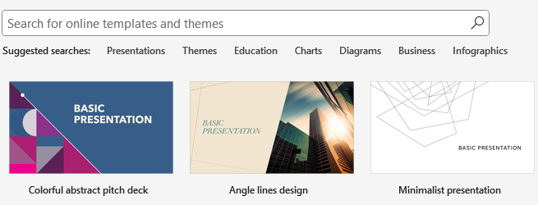
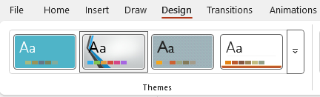
Templates and Themes
If you don’t want to design your presentation manually so you can use readymade templates from PowerPoint, canvas, slidesgo etc.
If you don’t like templates because you want to design by yourself then you can use themes to your slides from DESIGN tab.

Slide 6
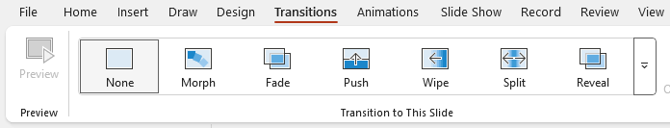
Slides Transitions
Transitions are visual effects that appear when we move from one slide to another.
They make the presentation more attractive and smooth.

Slide 7
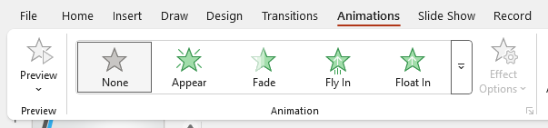
Animations
Animations in MS PowerPoint are effects applied to text, images, or objects on a slide. They help control how content appears, moves, or disappears during a presentation.
The Animations tab allows users to add, preview, and customize these effects.

Slide 8
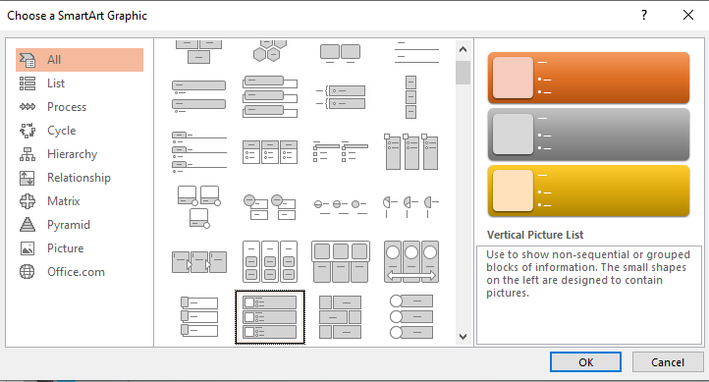
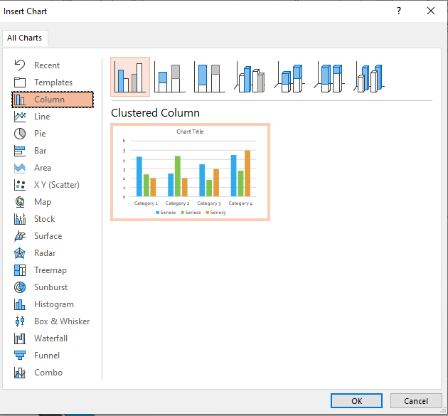
Charts & SmartArts
SmartArt is used to visually represent information like processes, relationships, and hierarchies. It helps make complex ideas easy to understand using diagrams and graphics.
Charts are used to display numerical data in formats like bar, pie, and line graphs. They help compare data and show trends clearly and effectively.

Slide 9
Collaboration Tools
Collaboration tools in MS PowerPoint allow multiple users to work on the same presentation together.
People can edit slides, add comments, and suggest changes in real time.
The Comments feature helps team members share feedback and ideas easily.
Version history allows users to track changes and restore previous versions.
Sharing options make it easy to invite others to view or edit the presentation.

Slide 10
Uses of MS PowerPoint
Classroom Presentations
Business Meetings
Project details or reports
Seminars and workshops

Slide 11
Conclusion
MS Powerpoint is an application software which is used to represent our slides including text, images, shapes, smartArt, transitions, animations and many more collaboration tools. It also includes voice recording and music in background to make more attractive presentation.

Slide 12
THANK YOU

